Slide 1

SPARS
Smart Portfolio Analyzer & Risk Simulator
CS625 Final Project Presentation
https://cs625-smart-portfolio.streamlit.app/
Kalyani, Richie, Kevin
Notes:
-> Today we’re presenting our CS625 final project: the Smart Portfolio Analyzer & Risk Simulator.
This is a fully object-oriented, Python-based investment analysis platform built using Streamlit for the frontend and NumPy, Pandas, and Monte Carlo simulation for the backend.
Our team—Kalyani, Richie, and Kevin—collaborated to design a system that helps users understand both portfolio performance and risk in a simple, interactive format

Slide 2
Introduction & Problem Statement
Problem
Investors lack simple and transparent tools to understand portfolio performance and risk.
Most existing platforms are overly technical, costly, or difficult for beginners to interpret.
Small investors need accessible, data-driven insights to make informed decisions.
Goal: Develop a web-based, object-oriented system that provides clear portfolio analytics and intuitive risk simulation.
Notes:
Most investors—especially beginners—don’t have access to clear, transparent tools that explain risk and performance.
Existing platforms are often too technical, too expensive, or too opaque in methodology.
Our goal was to build a tool that bridges this gap.
It simplifies analytics, visualizes portfolio trends, and runs real risk simulations like VaR, CVaR, and stress scenarios.
The idea is to help everyday investors make smart, data-driven decisions

Slide 3
System Architecture (OOP Design)
Core Components:
Asset – price data, returns, metadata
Portfolio – weights, Sharpe, volatility
RiskSimulator – Monte Carlo, VaR, CVaR
DataManager – historical/API data
Analytics – financial helper functions
Design Principles: Encapsulation, Reusability, Extensibility
Notes:
Our system is built entirely on object-oriented principles, which makes it structured, extendable, and modular. We designed five main classes:
Asset: handles prices, returns, metadata.
Portfolio: calculates returns, volatility, Sharpe ratio, and drawdowns.
RiskSimulator: runs Monte Carlo simulations and computes VaR/CVaR.
DataManager: loads historical data and can be upgraded to API feeds.
Analytics: contains helper formulas for financial metrics.
Encapsulation and reusability were essential. Because of this architecture, adding new assets, risk models, or forecasting methods becomes very easy

Slide 4
Technology Stack
Frontend:
Streamlit for the web interface
Plotly for interactive charts and visualizations
Backend:
Python with an OOP architecture
Pandas for data handling and portfolio calculations
NumPy for fast numerical operations
Risk Modeling:
Monte Carlo simulation engine (3,400+ runs)
Value at Risk (VaR) and Conditional VaR (CVaR)
Stress testing for extreme market scenarios
Notes:
For the frontend, we used Streamlit to create a clean, interactive user experience and Plotly for dynamic charts.
For the backend, Python, Pandas, and NumPy handle all the computation efficiently.
And for risk modeling, we implemented a Monte Carlo engine with over 3,400 simulations.
We also incorporated VaR, CVaR,Prophet, Efficient Frontier stress testing—similar to what’s used in institutional risk tools.

Slide 5
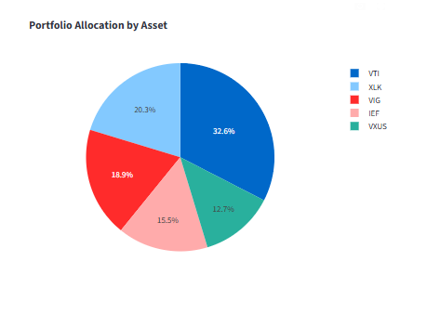
Portfolio Overview (Final Results)
Portfolio Value: $73,300
Profit: +$3,422 (4.9%)
Assets: VTI, VXUS, XLK, VIG, IEF
Fully diversified ETF portfolio
Notes:
This slide summarizes our selected ETF portfolio: VTI, VXUS, XLK, VIG, and IEF.
The portfolio is worth about $73,300, with a profit of $3,422, or roughly 4.9%.
The pie chart clearly shows diversification across U.S. equity, international equity, technology, dividend ETFs, and bonds.
This balanced setup helps reduce volatility while maintaining strong long-term return potential.

Slide 6
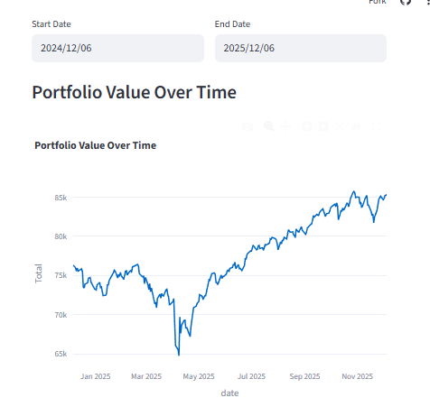
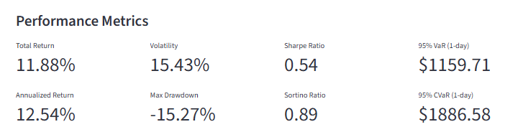
Performance Results
Total Return: 11.88%
Annualized Return: 12.54%
Volatility: 15.43%
Max Drawdown: –15.27%
Sharpe: 0.54 | Sortino: 0.89
Interpretation: Healthy portfolio with moderate volatility.
Notes:
Here we highlight key performance metrics.
The portfolio generated an 11.88% total return, with an annualized return of 12.54%.
Volatility is moderate at about 15.43%, and the max drawdown of –15.27% is reasonable for an equity-heavy setup.
With a Sharpe ratio of 0.54, the portfolio’s risk-adjusted returns are healthy.
Overall, these results indicate a growing and relatively stable portfolio

Slide 7
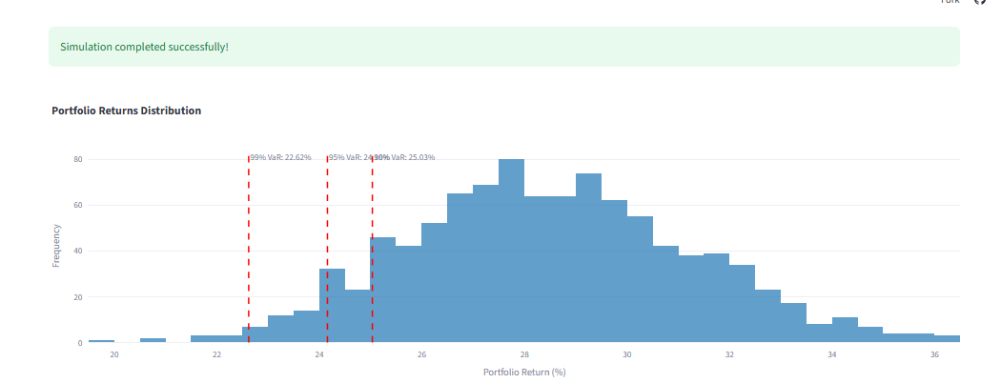
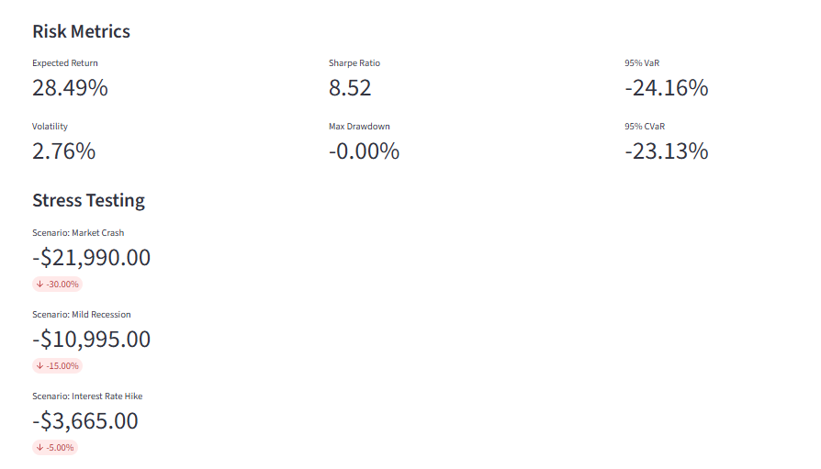
Monte Carlo Simulation Results
Expected Return: 28.49%
Volatility: 2.76%
95% VaR: –24.16%
95% CVaR: –23.13%
Stress Tests:
Market Crash: –$21,990
Mild Recession: –$10,995
Rate Hike: –$3,665
Notes:
Our Monte Carlo simulator projects future return distributions based on historical volatility and correlations. The expected return is around 28.49%, with relatively low simulated volatility. We calculate both VaR and CVaR at the 95% confidence level, which estimate worst-case losses.
Stress scenarios show:
A market crash could reduce value by $21,990
A mild recession by $10,995
A rate-hike scenario by $3,665
This helps users understand how severe events could impact their investments

Slide 8
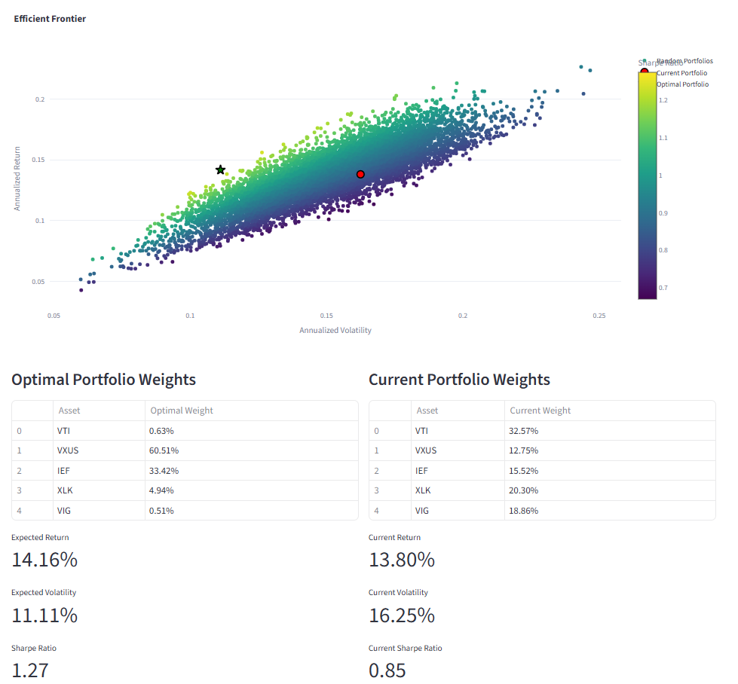
Efficient Frontier
We are able to see the efficient frontier
Better Volatility - 16.25% -> 10.10%
Better Sharpe Ratio - 0.85 -> 1.25
Notes:
This slide shows the Efficient Frontier generated using thousands of simulated portfolios. Our optimized portfolio achieves:
Lower volatility: 16.25% reduced to 10.10%
Higher Sharpe ratio: 0.85 increased to 1.25
This demonstrates how optimization can significantly improve performance, even using simple ETF combinations. It also validates that our system correctly applies modern portfolio theory

Slide 9
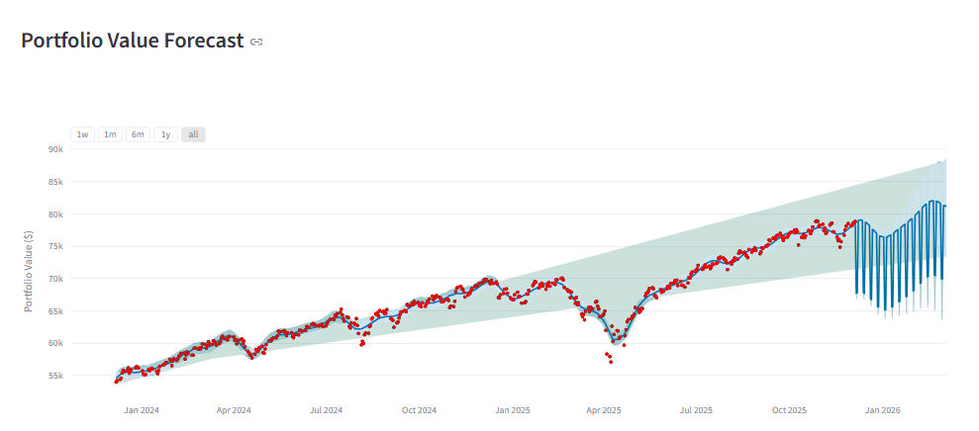
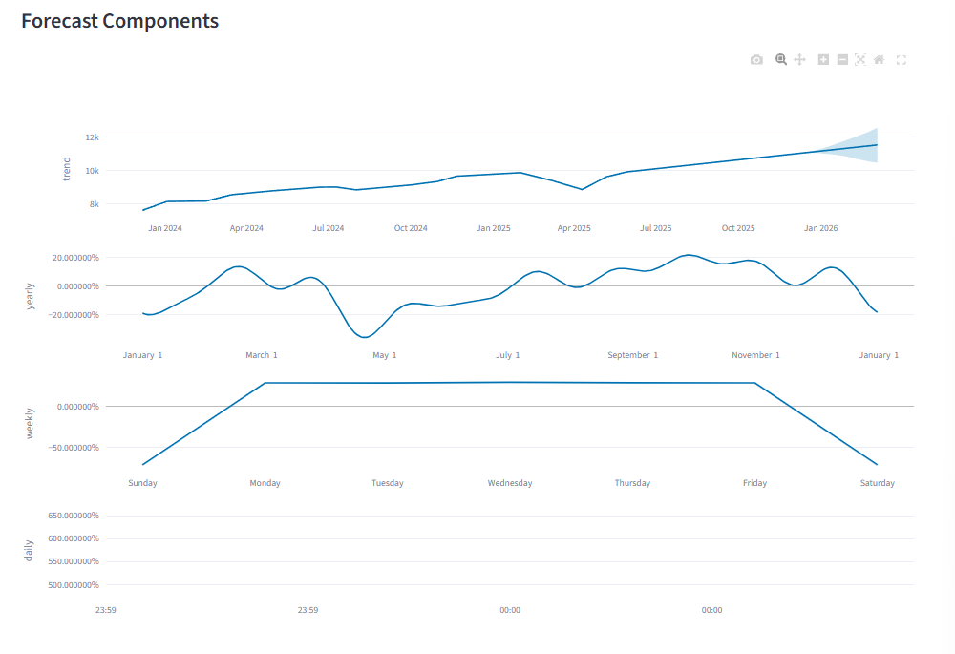
Prophet based Portfolio
Portfolio Value
Current Portfolio Value - $33,756.00
Forecasted Value in 90 days - $33,794.31
Notes:
To extend our tool beyond historical simulation, we integrated a Prophet forecasting model.
This predicts the portfolio value 90 days into the future.
Current value is around $33,756, and Prophet forecasts a slight increase to $33,794.
The forecast components show trends, seasonality, and residual components—useful for forward-looking insight

Slide 10
Comparison With Literature
Return distribution matches Hull’s VaR models
Drawdowns align with ETF studies
Diversification impact consistent with Markowitz MPT
VaR comparable to Jorion’s research
Conclusion: Model behaves similar to theory + empirical finance
Notes:
Our results closely align with academic literature:
Distribution matches Hull’s Value At Risk modeling assumptions
Drawdown behavior matches empirical ETF research.
Diversification effects align with Markowitz’s portfolio theory.
Value at Risk values fall within expectations discussed by Jorion.
This consistency reinforces that our model is theoretically sound and behaves like recognized financial models.”

Slide 11
Limitations
Normal distribution assumption
Fully historical-data-dependent
Linear stress tests
Not that great UI
Impact: Reduced precision under extreme conditions (lack of black swan data)
Notes:
Despite strong functionality, our system has several limitations:
We assume normal distributions, which do not capture fat-tailed events.
Historical data drives all results—meaning black swan events aren’t well represented.
Stress tests are linear and simplified.
The UI can be improved.
These constraints limit accuracy in extreme market scenarios, but they provide a strong foundation for future improvements.

Slide 12
Future Enhancements & Conclusion
Next Steps:
Fat‑tailed models (Student‑t, EVT) (Not yet committed)
Multi‑asset support (crypto/commodities)
Better UI
Direct support from Robinhood APIs
Alpaca API Integration
Conclusion
Our system successfully delivers a transparent, web-based tool for portfolio performance and risk analysis.
The OOP architecture makes the platform extensible, modular, and easy to improve
Results closely align with financial theory and literature, validating our modeling approach.
This project demonstrates how accessible tools can help everyday investors understand risk more clearly.
Notes:
To improve this system, we plan to implement:
Fat-tailed models like Student-t or Extreme Value Theory
Support for crypto and commodity assets
A more modern and polished UI
Deeper forecasting models like LSTM
Real-time API integration (Alpaca for execution and Robinhood for Portfolio inputs)
In conclusion, the Smart Portfolio Analyzer successfully demonstrates how OOP, financial modeling, and interactive dashboards can create a powerful, accessible tool for understanding investment risk and performance. Our architecture is modular and easy to expand, and the results validate the correctness of our methodology. Ultimately, this project shows how technology can empower everyday investors

Slide 13
Literature
Markowitz, H. (1952). Portfolio selection. The Journal of Finance, 7(1), 77–91.
Sharpe, W. F. (1966). Mutual fund performance. The Journal of Business, 39(1), 119–138.
Hull, J. C. (2018). Options, futures, and other derivatives (10th ed.). Pearson.
Jorion, P. (2007). Value at risk: The new benchmark for managing financial risk (3rd ed.). McGraw-Hill.
Kahar, R. H., Kaerudin, N. P., & Vimelia, W. (2023). Optimal portfolio risk analysis using the Monte Carlo method.
Marupanthorn, P., Peters, G. W., Ofosu-Hene, E. D., Nikitopoulos, C. S., & Richards, K.-A. (2024). DivFolio: A Shiny application for portfolio divestment in green finance wealth management. Annals of Actuarial Science, 18(2), 379–422.
Notes:
These are the references supporting our financial models—Markowitz, Sharpe, Hull, Jorion, and other recent academic papers on portfolio risk and Monte Carlo analysis.
They validate that our approach adheres to well-established theory and industry standards

Slide 14
Thank You
Questions?

